Slide 1

PHISHING AWARENESS:
ONLINE TRAINING MODULE

Slide 2
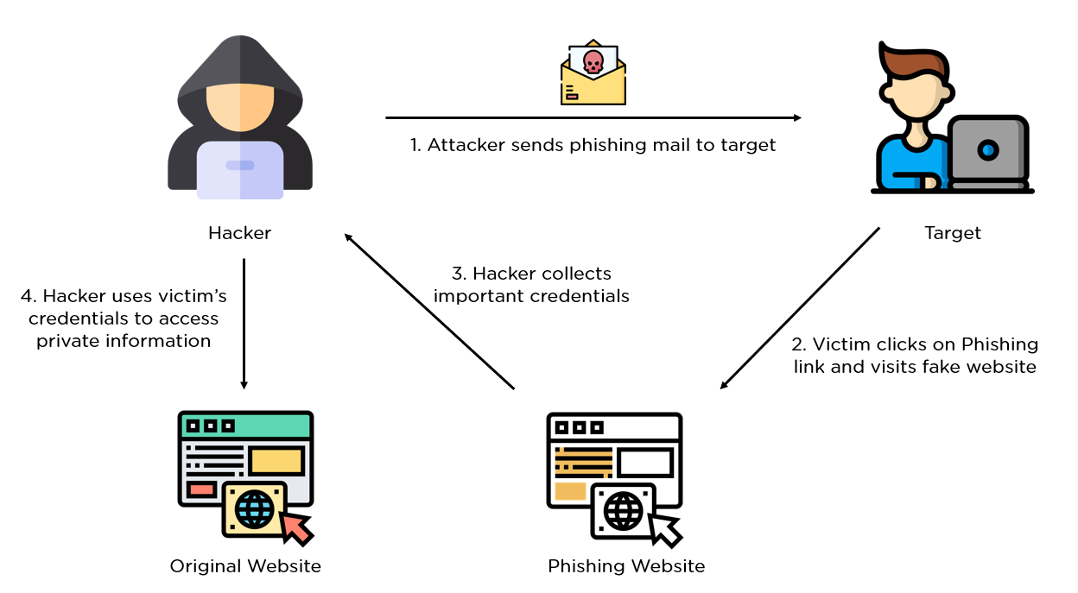
What is phishing?
Phishing is a sort of cyberattack in which dishonest persons or groups attempt to fool victims into divulging private information such as credit card numbers, passwords, or personal information. This is typically done through deceptive emails, messages, or websites that appear to be legitimate but are actually designed to steal information. Phishing attempts frequently take advantage of human psychology such as creating a sense of urgency or fear to persuade individuals to disclose their sensitive information.

Slide 3
Phishing emails can be a common threat and lead to cyberattacks like data breaches or ransomware infections. To recognize phishing tactics, you can look for these common traits:
Malicious attachments: According to a study, 94% of phishing emails use malicious attachments as the infection source.
Urgent action: Phishing emails may create a false sense of urgency by claiming that you must act immediately to avoid punishment or receive a reward.
Poor grammar and spelling: Most businesses have spell check enabled for outbound emails, so bad spelling and incorrect grammar can be a sign of a phishing email.
Unfamiliar greeting: The salutation or greeting in the email may be unfamiliar.Requests for sensitive data: Phishing emails may request login credentials, payment information, or other sensitive data.
Inconsistencies: There may be inconsistencies in the email address, links, or domain names.
Sender address: For internal emails, hackers may not be able to replicate the specific email URL, so you can double-check the sender address.

Slide 4

Angler Phishing
Email Phishing
Spear Phishing
Types of Phishing
Clone Phishing
Smishing
and Vishing
Whaling

Slide 5
Email phishing:- Most phishing attacks are sent via email. Attackers typically register fake domain names that mimic real organizations and send thousands of common requests to victims.
Many phishing emails use a sense of urgency or a threat to cause a user to comply quickly without checking the source or authenticity of the email.
Email phishing messages have one of the following goals:
Causing the user to click a link to a malicious website in order to install malware on their device.
Causing the user to download an infected file and using it to deploy malware.
Causing the user to click a link to a fake website and submit personal data.
Causing the user to reply and provide personal data.
Spear phishing:- Spear phishing is a type of phishing attack that targets a specific individual, group or organization. These personalized scams trick victims into divulging sensitive data, downloading malware or sending money to an attacker.
The attacker typically already has some or all of the following information about the victim:
Name
Place of employment
Email address
Specific information about their job role
Trusted colleagues, family members, or other contacts, and samples of their writing

Slide 6
Whaling:- Whaling attacks, often referred to as CEO fraud or executive phishing, are sophisticated cyberthreats targeting an organization's high-profile individuals. The term whaling reflects the high status of these targets, who have significant access to critical data and financial assets.
Transferring large sums of corporate money to the attacker's fraudulent accounts.
Divulging sensitive or confidential information, such as trade secrets, client data, or login credentials.
Granting access to secure systems, networks, or databases.
Executing unauthorized actions that can compromise the organization's security or operations, such as endorsing contracts or making policy changes.
4. Smishing and Vishing:- This is a phishing attack that uses a phone instead of written communication.
Smishing involves sending fraudulent SMS messages, while vishing involves phone conversations.
In a typical voice phishing scam, an attacker pretends to be a scam investigator for a credit card company or bank, informing victims that their account has been breached.
Criminals then ask the victim to provide payment card information, supposedly to verify their identity or transfer money to a secure account (which is really the attacker’s).
Vishing scams may also involve automated phone calls pretending to be from a trusted entity, asking the victim to type personal details using their phone keypad.

Slide 7
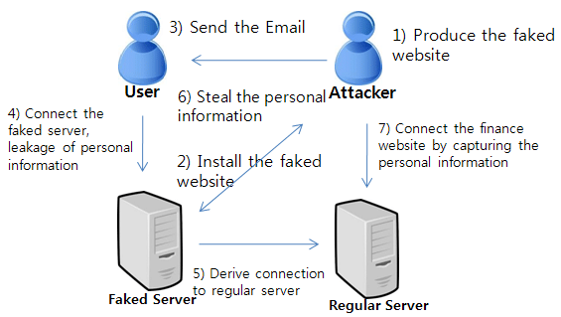

Slide 8
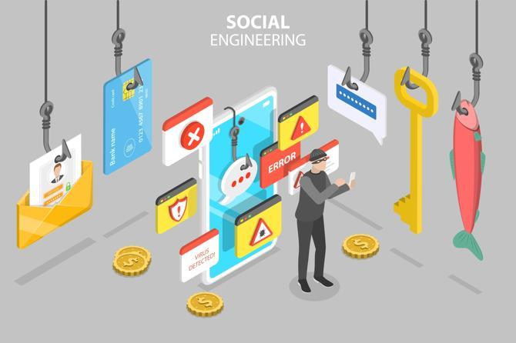
Phishing in-terms of Social Engineering
Social engineering is the tactic of manipulating, influencing, or deceiving a victim in order to gain control over a computer system, or to steal personal and financial information. It uses psychological manipulation to trick users into making security mistakes or giving away sensitive information. Phishing is a particular type of social engineering attack. The process of attempting to acquire sensitive information such as usernames, passwords, and credit card details by masquerading as a trustworthy entity using bulk email, SMS text messaging, or by phone. Phishing messages create a sense of urgency, curiosity, or fear in the recipients of the message. The message will prod victims into revealing sensitive information, clicking on links to malicious websites, or opening attachments that contain malware.

Slide 9
How to prevent phishing
To help prevent phishing messages from reaching end users, experts recommend layering security controls with the following tools:
Antivirus Software.
Desktop and network firewall.
Antispyware software.
Anti-phishing toolbar installed in web browsers.
Gateway Email Filter.
Web security gateway.
Spam filter.
Phishing filters from vendors such as Microsoft.

Slide 10
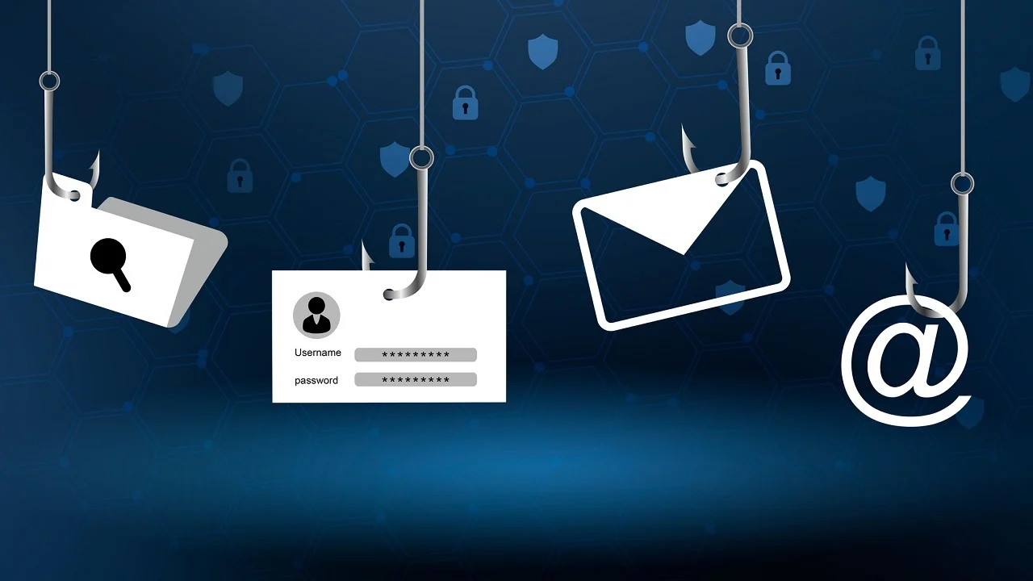
BE AWARE OF CYBER ATTACKS !!!

